Slide 1
Discrete Mathematics and Logic (UE18CS205) Unit 3 - Counting
Mr. Channa Bankapur, Prof. Sangeeta V I
Department of CS&E, PES University

Slide 2
Counting is a basic human trait. There is archeological evidence suggesting that humans have been counting for at least 50,000 years.
Combinatorics is the study of arrangement of objects.
Counting is the significant part of Combinatorics. It is the action of finding the number of elements of a finite set of objects.
In mathematics, the essence of counting a set (cardinality of) and finding a result n, is that it establishes a one-to-one correspondence of the set with the set of natural numbers {0, 1, 2, ..., n}.
‹#›

Slide 3
Applications of Counting:
There are uncountable (sorry, countable, but large) number of applications of counting. Here are the ones you need in the near future.
Probability
Graph Theory
Analysis of algorithms.
Design of Algorithms
Algorithms which inherently need counting methods like in Analytics.
…
‹#›

Slide 4
The kind of problems dealt in this Unit:
Suppose that a password for an encrypted network packet is 8 to 15 characters long. The password is alphanumeric and case-sensitive. The password has at least one digit and at least one alphabet.
How many passwords a hacker needs to loop through to decode a network packet in the worst-case?
<You don’t have to try to solve this for now!>
‹#›

Slide 5
Topics to be covered in Counting:
The Product Rule and the Sum Rule
The Pigeonhole Principle
Permutation and Combination
Binomial Theorem and Coefficients
‹#›

Slide 6
Suppose, you are asked to choose a course from Elective-1 pool and one from Elective-2 pool. There are 5 courses offered in Elective-1 pool and 4 courses in Elective-2 pool. How many different ways are there for you to choose a pair of Elective-1 and Elective-2 ?
Suppose, department of CSE is offering 5 courses in Elective-1 pool and department of ECE is offering 4 courses in Elective-1 pool. A student is asked to choose one course from Elective-1 pool irrespective of the department. How many different ways are there for you to choose a course in Elective-1 ?
CSE offers 5 and 4 courses, ECE offers 4 and 3 courses for E-1 and E-2 pools, respectively. How many different ways are there for you to choose a pair of Elective-1 and Elective-2 ?
‹#›

Slide 7
The Product Rule
Suppose that a procedure can be broken down into a sequence of two tasks. If there are n₁ ways to do the first task and for each of these ways of the first task, there are n₂ ways to do the second task, then there are n₁*n₂ ways to do the procedure.
Eg: To order a pizza, you first choose the type of crust: thin or deep dish (2 choices). Next, you choose the topping: cheese, pepperoni, or sausage (3 choices). Therefore, there are
2 × 3 = 6 possible ways of ordering a pizza.
‹#›

Slide 8
Eg: Suppose, there are 7 trains from Bangalore to Mumbai and 3 trains from Mumbai to Ahmedabad. In how many ways our Pappu can reach Ahmedabad from Bangalore?
Soln: From Bangalore to Mumbai, Pappu has 7 choices (because there are 7 trains, he can pick anyone). For each of the choice of the first stage, he has 3 choices from Mumbai to Ahmedabad.
Total # of ways = 7 ways x 3 ways = 21 ways.
Pappu can reach Ahmedabad in 21 different ways.
‹#›

Slide 9
What does it return?
foo(n)
ctr ← 0
for i ← 1 to 20
for j ← 1 to 30
ctr ← ctr + 1
return ctr
Return value: …
‹#›

Slide 10
What does it return?
foo(n)
ctr ← 0
for i ← 1 to 20
for j ← 1 to 30
ctr ← ctr + 1
return ctr
Return value: Return value: 20*30 = 600
(the product rule)
‹#›

Slide 11
Eg: Suppose there are 10 contestants for a race. There will be a 1st and a 2nd prize winners. In how many ways the prizes can be awarded?
Soln: …
‹#›

Slide 12
Eg: Suppose there are 10 contestants for a race. There will be a 1st and a 2nd prize winners. In how many ways the prizes can be awarded?
Soln: There are 10 ways to choose the 1st prize winner. For each of the 10 ways, there are 9 ways to choose the 2nd prize winner.
Therefore, 10 * 9 = 90 ways.
‹#›

Slide 13
Eg: Suppose there are five empty chairs in a row. A couple (two people) is allowed to occupy any of the seats. How many unique ways are there for them to sit?
OR
How many ways are there to arrange two people in five chairs?
Soln: …
‹#›

Slide 14
Eg: Suppose there are five empty chairs in a row. A couple (two people) is allowed to occupy any of the seats. How many unique ways are there for them to sit?
OR
How many ways are there to arrange two people in five chairs?
Soln: 5 * 4 = 20 ways
Orders matters here. It’s not just about which two chairs are occupied. It’s also about who among the two sits on it.
That is, chairs are labeled and so are the people.
‹#›

Slide 15
Eg: Suppose there are five empty chairs in a row. Three people are allowed to occupy any of the seats. How many unique ways are there for the them to sit?
Soln: …
‹#›

Slide 16
Eg: Suppose there are five empty chairs in a row. Three people are allowed to occupy any of the seats. How many unique ways are there for the them to sit?
Soln: 5 * 4 * 3 = 60 ways
Eg: Suppose there is a pool of five elective courses to choose one from. Three friends choose one each. In how many ways they can choose the electives?
Soln: …
‹#›

Slide 17
Eg: Suppose there are five empty chairs. Three people are allowed to occupy any of the seats. How many unique ways are there for the them to sit?
Soln: 5 * 4 * 3 = 60 ways
Eg: Suppose there is a pool of five elective courses to choose one from. Three friends choose one each. In how many ways they can choose the electives?
Soln: 5 * 5 * 5 = 125 ways
Choices are allowed with replacement.
In the previous example of “seats”, it’s without replacement.
‹#›

Slide 18
Generalization of the Product Rule
Suppose that a procedure is carried out by performing the tasks T₁, T₂, …, T_{m} in sequence. If each task T_{i} can be done in n_{i} ways, regardless of how the previous tasks were done, then there are n₁ * n₂ * … * n_{m} ways to do the procedure.
Eg: When assembling a certain type of computer, there are 3 choices of hard drive, 4 choices for the amount of memory, 2 choices of video card, and 3 choices of monitor. The number of ways a computer can be assembled is 3*4*2*3 = 72 ways.
‹#›

Slide 19
Eg: Suppose there are 10 contestants for a race. There will be a 1st, a 2nd and a 3rd prize winners. How many ways the prizes can be awarded?
Soln: ...
‹#›

Slide 20
Eg: Suppose there are 10 contestants for a race. There will be a 1st, a 2nd and a 3rd prize winners. How many ways the prizes can be awarded?
Soln: There are 10 ways to choose the 1st prize winner. For each of the 10 ways, there are 9 ways for the 2nd prize winner. For each of the 10 * 9 ways, there are 8 ways for the 3rd prize winner.
Therefore, 10 * 9 * 8 = 720 ways.
‹#›

Slide 21
Eg: Suppose four people sit on four of the available five empty chairs. How many ways are there for them to sit when the order of their seating matters?
Soln: …
‹#›

Slide 22
Eg: Suppose four people sit on four of the available five empty chairs. How many ways are there for them to sit when the order of their seating matters?
Soln: There are 5 ways to choose a chair for the first person. For each of the 5 ways, there are 4 ways for the second person to choose a chair. For each of the 5*4 ways, there are 3 ways for the third person to choose a chair. For each of the 5*4*3 ways, there are 2 ways for the fourth person to choose a chair.
Therefore, 5 * 4 * 3 * 2 = 120 ways.
‹#›

Slide 23
Eg: Suppose that a password for encrypted network packet is eight characters long, alphanumeric and case-sensitive. How many passwords a hacker needs to loop through to decode the network packet in the worst-case?
Soln: …
‹#›

Slide 24
Eg: Suppose that a password for encrypted network packet is eight characters long, alphanumeric and case-sensitive. How many passwords a hacker needs to loop through to decode the network packet in the worst-case?
Soln: 62*62*62*62*62*62*62*62 = 62⁸ different possibilities of the password.
‹#›

Slide 25
What is the value of ctr printed?
ctr = 0
for i = 1 to 100
for j = 1 to 500
for k = 1 to 1000
ctr = ctr + 1
print ctr
Output: …
‹#›

Slide 26
What is the value of ctr printed?
ctr = 0
for i = 1 to 100
for j = 1 to 500
for k = 1 to 1000
ctr = ctr + 1
print ctr
Output: 50,000,000
(= 100 * 500 * 1000)
‹#›

Slide 27
What is the value of k printed?
k = 0
for i₁ = 1 to n₁
for i₂ = 1 to n₂
.
.
for i_{m} = 1 to n_{m}
k = k + 1
print k
Output: n₁ * n₂ * ... * n_{m}
‹#›

Slide 28
Eg: An ATM card takes a 4-digit secret pin code to draw money from the ATM. Suppose a thief steals an ATM card. How many combinations the thief has to try at worst to steal some money?
Soln: …
Eg: What if the thief knows that the pin code has unique digits in it (no digit is repeated) ?
Soln: …
Eg: What if the thief knows that the pin code is a palindrome (it reads the same backwards as forwards) ?
Soln: …
‹#›

Slide 29
Eg: An ATM card takes a 4-digit secret pin code to draw money from the ATM. Suppose a thief steals an ATM card. How many combinations the thief has to try at worst to steal some money?
Soln: 10 * 10 * 10 * 10 = 10⁴ different possibilities of the pin code.
Eg: What if the thief knows that the pin code has unique digits in it (no digit is repeated) ?
Soln: 10 * 9 * 8 * 7 = 5040
Eg: What if the thief knows that the pin code is a palindrome (it reads the same backwards as forwards) ?
Soln: 10*10*1*1 = 100
‹#›

Slide 30
The Sum Rule
If a task can be done in one of n₁ ways or in one of n₂ ways, where none of the set of n₁ ways is the same as any of the set of n₂ ways, then there are n₁+ n₂ ways to do the task.
Eg: CSE department offers five elective courses and ECE department offers four electives for an electives pool from which a student has to pick one. How many different ways a student can pick if he/she is allowed to pick only one elective?
Soln: 5 + 4 = 9 choices
‹#›

Slide 31
Generalization of the Sum Rule
If a task can be done in one of n₁ ways or in one of n₂ ways or … or in one of n_{m} ways, then there are n₁+n₂ +…+n_{m} ways to do the task.
Eg: CSE department offers five elective courses, ECE department offers four and MCA department offers two for an electives pool from which a student has to pick one. How many different ways a student can pick if he/she is allowed to pick only one elective?
Soln: 5 + 4 + 2 = 11 choices
‹#›

Slide 32
Eg: Suppose that a password for an encrypted network packet is 3 to 5 characters long, alphanumeric and case-sensitive. How many passwords a hacker needs to loop through in the worst case to decode the network packet?
Soln: …
‹#›

Slide 33
Eg: Suppose that a password for an encrypted network packet is 3 to 5 characters long, alphanumeric and case-sensitive. How many passwords a hacker needs to loop through in the worst case to decode the network packet?
Soln: Number of passwords of length 3:
62*62*62 = 62³ ---using the product rule
Number of passwords of length 3, 4 or 5:
62³ + 62⁴ + 62⁵ ---using the sum rule
‹#›

Slide 34
What is the value of k printed?
k=0
for i₁=1 to n₁
k = k+1
for i₂=1 to n₂
k = k+1
.
.
for i_{m}=1 to n_{m}
k = k+1
print k
Output: n₁+ n₂+...+ n_{m}
‹#›

Slide 35
What is the value of ctr printed?
ctr = 0
for i = 1 to 10
for j = 1 to 50
for k = 1 to 10
ctr = ctr + 1
for i = 1 to 20
for j = 1 to 60
for k = 1 to 10
ctr = ctr + 1
print ctr
Output: …
‹#›

Slide 36
What is the value of ctr printed?
ctr = 0
for i = 1 to 10
for j = 1 to 50
for k = 1 to 10
ctr = ctr + 1
for i = 1 to 20
for j = 1 to 60
for k = 1 to 10
ctr = ctr + 1
print ctr
Output: 17,000
( = 10 * 50 * 10 + 20 * 60 * 10)
‹#›

Slide 37
Eg: In an earlier version of the computer programming language BASIC, the name of a variable is a string of one or two alphanumeric case-insensitive characters. Moreover, a variable name must begin with a letter and must be different from the five keywords of two character length. How many different variable names are there in this version of BASIC?
Soln: …
‹#›

Slide 38
Eg: In an earlier version of the computer programming language BASIC, the name of a variable is a string of one or two alphanumeric case-insensitive characters. Moreover, a variable name must begin with a letter and must be different from the five keywords of two character length. How many different variable names are there in this version of BASIC?
Soln: 26 + (26 * 36 - 5)
= 26 + 931 = 957
‹#›

Slide 39
Eg: Suppose the password for a system is 6 characters long where each character is a lowercase letter or a digit. Each password must contain at least one digit. How many possible passwords are there?
Soln: …
‹#›

Slide 40
Eg: Suppose the password for a system is 6 characters long where each character is a lowercase letter or a digit. Each password must contain at least one digit. How many possible passwords are there?
Soln: (36⁶ - 26⁶) = 1,867,866,560
Why are the following not correct?
36⁵ * 10 = 604,661,760
36⁵ * 10 * 6 = 3,627,970,560
36⁵ + 10 * 6 = 60,466,236
(26⁵ + 10) * 6 = 71,288,316
‹#›

Slide 41
Eg: Suppose the password for a system is 6 to 8 characters long where each character is a lowercase letter or a digit. Each password must contain at least one digit. How many possible passwords are there?
Soln: …
‹#›

Slide 42
Eg: Suppose the password for a system is 6 to 8 characters long where each character is a lowercase letter or a digit. Each password must contain at least one digit. How many possible passwords are there?
Soln: (36⁶ - 26⁶) + (36⁷ - 26⁷) + (36⁸ - 26⁸)
‹#›

Slide 43
Eg: An RTO in India has an unique code. For example, the code for Jayanagar-Bangalore is KA05. Suppose the licence number plates issued by the Jayanagar RTO are in the format KA05-XX-YYYY, where an ‘X’ represents an uppercase English letter and a ‘Y’ represents a digit. How many unique licence numbers the Jayanagar RTO can issue?
Soln: …
Eg: How many different bit strings of length eight are there?
Soln: …
‹#›

Slide 44
Eg: An RTO in India has an unique code. For example, the code for Jayanagar-Bangalore is KA05. Suppose the licence number plates issued by the Jayanagar RTO are in the format KA05-XX-YYYY, where an ‘X’ represents an uppercase English letter and a ‘Y’ represents a digit. How many unique licence numbers the Jayanagar RTO can issue?
Soln: 26 * 26 * 10 * 10 * 10 * 10
= 26² * 10⁴
= 6,760,000
‹#›

Slide 45
Eg: How many different bit strings of length eight are there?
Soln: 2 * 2 * 2 * 2 * 2 * 2 * 2 * 2
= 2⁸
= 256
Eg: How many bit strings of length eight starts with “1” and ends with “00”?
Soln: …
‹#›

Slide 46
Eg: How many bit strings of length eight start with a ‘1’ and end with ‘00’?
Soln: 1 * 2 * 2 * 2 * 2 * 2 * 1 * 1
= 2⁵
= 32
Eg: How many bit strings of length eight start with a ‘1’ or end with ‘00’?
Soln: …
‹#›

Slide 47
Eg: How many bit strings of length eight start with a ‘1’ or end with ‘00’?
It is not 2⁷ + 2⁶ because the objects like 1xxxxx00 are counted twice.
Soln: 2⁷ + 2⁶ - 2⁵
= 128 + 64 - 32
= 160
Alternate method:
Soln: 2⁸ - (1 * 2⁵ * 3)
= 256 - 96
= 160
‹#›

Slide 48
The Inclusion-Exclusion Principle
(aka Subtraction Principle)
It’s essentially subtracting some cases out of the Sum rule.
In the Sum rule, we add the possibilities of two stages of the procedure because there is no overlap among the stages.
In cases where there is a partial overlap between the stages of the procedure, we need to subtract the common cases after applying the Sum rule.
|A₁ U A₂| = |A₁| + |A₂| - |A₁ ∩ A₂|
‹#›

Slide 49
Eg: How many subsets of a set with 100 elements have more than one element?
Soln: …
Eg: A palindrome is a string that reads same backwards as forwards. How many bit strings of length n are palindromes?
Soln: …
‹#›

Slide 50
Eg: How many subsets of a set with 100 elements have more than one element?
Soln: 2¹⁰⁰ - (1+100)
Eg: A palindrome is a string that reads same backwards as forwards. How many bit strings of length n are palindromes?
Soln: 2^{ceil(n/2)}
‹#›

Slide 51
Eg: In how many ways can a photographer at a wedding arrange 6 people in a row from a group of 10 people, where the bride and the groom are among these 10 people, if
the bride must be in the picture?
both bride and groom must be in the picture?
exactly one of the bride and the groom is in the picture?
Soln:
a. …
b. …
c. …
‹#›

Slide 52
Eg: In how many ways can a photographer at a wedding arrange 6 people in a row from a group of 10 people, where the bride and the groom are among these 10 people, if
the bride must be in the picture?
both bride and groom must be in the picture?
exactly one of the bride and the groom is in the picture?
Soln: 10*9*8*7*6*5 = 151200
a. 151200 - (9*8*7*6*5*4) = 90720 OR
9*8*7*6*5*(6) = 90720
b. 8*7*6*5*(5*6) = 50400
c. 8*7*6*5*4*(6+6) = 80640
151200 - (50400 + 8*7*6*5*4*3)
‹#›

Slide 53
Eg: In how many ways can a photographer at a wedding arrange 6 people in a row, including the bride and the groom, if
the bride must be next to the groom?
the bride is not next to the groom?
the bride is positioned somewhere to the left of the groom?
Soln:
…
…
…
‹#›

Slide 54
Eg: In how many ways can a photographer at a wedding arrange 6 people in a row, including the bride and the groom, if
the bride must be next to the groom?
the bride is not next to the groom?
the bride is positioned somewhere to the left of the groom?
Soln: 6*5*4*3*2*1 = 720
5*4*3*2*1*(2) = 240
720 - 240 = 480
720/2 = 360
‹#›

Slide 55
Eg: How many bit strings of length seven begin with two 0s or end with three 1s?
Soln: …
Eg: How many bit strings of length ten begin with three 0s or end with two 0s?
Soln: …
‹#›

Slide 56
Eg: How many bit strings of length seven begin with two 0s or end with three 1s?
Soln: 2⁵ + 2⁴ - 2²
Eg: How many bit strings of length ten begin with three 0s or end with two 0s?
Soln: 2⁷ + 2⁸ - 2⁵
‹#›

Slide 57
Are these statements true?
Suppose 11 pigeons flies into a set of 10 pigeonholes to roost. At least one of the 10 pigeonholes must have at least 2 pigeons in it.
When 11 random single-digit nonnegative integers are generated, at least one of them is generated at least twice.
For a positive integer k, if k + 1 or more objects are placed into k boxes, then there is at least one box containing two or more objects.
‹#›

Slide 58
Theorem: The Pigeonhole Principle
If k is a positive integer and k + 1 or more objects are placed into k boxes, then there is at least one box containing two or more objects.
Proof: by contraposition.
If none of the k boxes contains more than one object, then total number of objects cannot be more than k.
Corollary: A function f from a set with k+1 or more elements to a set with k elements cannot be one-to-one.
‹#›

Slide 59
Examples of the pigeonhole principle:
Among a group of 480 students, there must be at least two with the same birthday.
Among a group of 367 people, there must be at least two with the same birthday.
In a random collection of 27 letters, there must be at least two similar letters.
How many students must be there in a classroom to guarantee that at least two students receive the same score in the test, if the test is graded on a scale from 0 to 40 marks (rounded off to whole numbers)?
Soln: 42
‹#›

Slide 60
Eg: Show that for every positive integer n, there is a multiple of n that has only 0s and 1s in its decimal expansion.
Soln:
…
‹#›

Slide 61
Eg: Show that for every positive integer n, there is a multiple of n that has only 0s and 1s in its decimal expansion.
Soln:
Consider n + 1 integers 1, 11, 111, …, 11...1 (the last one has n + 1 digits)
According to the Pigeonhole principle, at least two of them has the same remainder when divided by n.
Difference of the two numbers with the same remainders is a multiple of n and has only 0s and 1s.
‹#›

Slide 62
Eg: Suppose 21 pigeons flies into a set of 10 pigeonholes to roost. Then at least one of the 10 pigeonholes must have at least 3 pigeons in it.
Eg: Suppose a professor takes 16 hours of lectures in a week of 5 days. On at least on one of the days, he/she has to take at least 4 hours of lectures.
‹#›

Slide 63
Eg: Suppose 21 pigeons flies into a set of 10 pigeonholes to roost. Then at least one of the 10 pigeonholes must have at least 3 pigeons in it.
The Generalized Pigeonhole Principle:
If N objects are placed into k boxes, then there is at least one box containing at least ⌈N/k⌉ objects.
Eg: Among 60 students in a classroom, there are at least ⌈60/7⌉ = 9 who are born on the same day of the week.
‹#›

Slide 64

‹#›

Slide 65
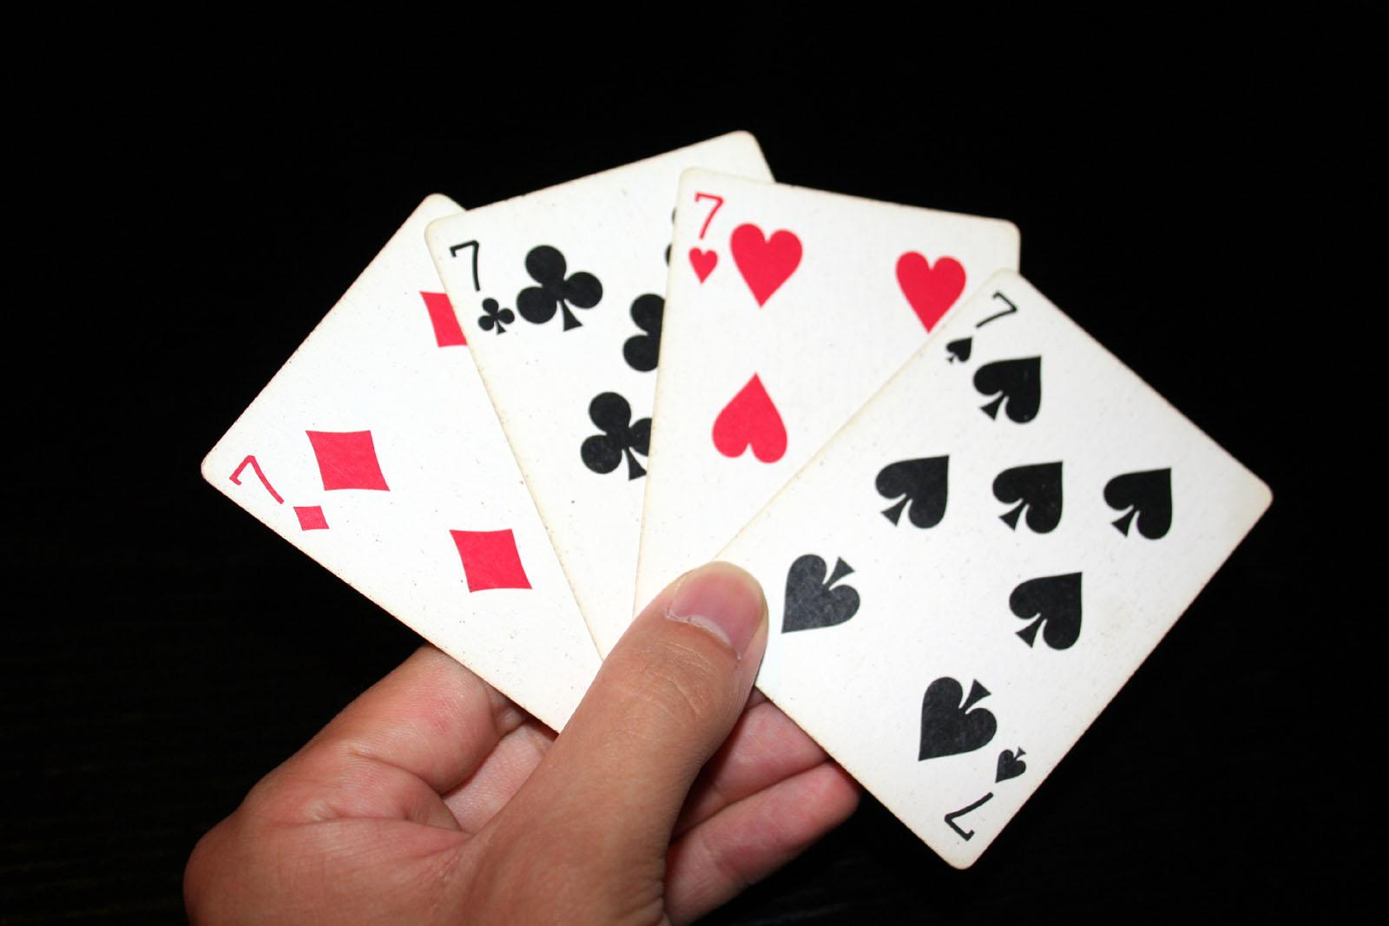
Eg: What is the minimum number of cards that must be drawn from a standard deck of 52 cards to guarantee that at least three cards of the same suit are chosen?
Soln: …
Eg: What is the minimum number of cards that must be selected to guarantee that at least three hearts are selected?
Soln: …
‹#›

Slide 66
Eg: What is the minimum number of cards that must be drawn from a standard deck of 52 cards to guarantee that at least three cards of the same suit are chosen?
Soln: Lowest nonnegative int x for which ceil(x/4) = 3.
Therefore, x = 9
Eg: What is the minimum number of cards that must be selected to guarantee that at least three hearts are selected?
Soln: 39 + 3
‹#›

Slide 67
Harder problems (pigeonhole principle):
Eg [OPTIONAL]: During a month with 30 days, a baseball team plays at least one game a day, but no more than 45 games (in the month). Show that there must be a period of some number of consecutive days during which the team must play exactly 14 games.
Eg: 1,1,2,1,3,2,1,1,1,4,5,1,1,1,1,1,2,1,1,1,1,1,2,3,1,1,1,2,1,1
‹#›

Slide 68
Eg: 1,1,2,1,3,2,1,1,1,4,5,1,1,1,1,1,2,1,1,1,1,1,2,3,1,1,1,2,1,1
a_{j} be the number of games played till j^{th} day.
a₁, a₂, …, a₃₀.
Eg: 1,2,4,5,8,10,11,12,13,17,22,23, …, 41,43,44,45
This is a strictly increasing sequence of distinct integers in the range [1,45].
a₁+14, a₂+14, …, a₃₀+14 is a strictly increasing sequence of distinct integers in the range [15,59]
Eg: 15,16,18,19,22, …, 55,57,58,59
‹#›

Slide 69
a₁, a₂, …, a₃₀ is a strictly increasing sequence of distinct integers in the range [1,45].
a₁+14, a₂+14, …, a₃₀+14 is a strictly increasing sequence of distinct integers in the range [15,59].
Put together, 60 integers in the range [1,59]
By Pigeonhole principle, at least two of these integers are equal.
∃i ∃j a_{i} = a_{j} + 14 and i > j
1 ,1 ,2 ,1 ,3 ,2 ,1 ,1 ,1 ,4 ,5 ,…
1 ,2 ,4 ,5 ,8 ,10,11,12,13,17,22,… (a₁, a₂, a₃, …)
15,16,18,19,22,… (a₁+14, a₂+14, a₃+14, …)
‹#›

Slide 70
By Pigeonhole principle, at least two of these integers are equal.
∃i ∃j a_{i} = a_{j} + 14 and i > j
01,01,02,01,03,02,01,01,01,04,05,...
a_{i}: 01,02,04,05,08,10,11,12,13,17,22,...
a_{i}+14: 15,16,18,19,22,...
In the example, a₁₁ = a₅+14 = 22. Until day 5, they’ve played 08 games and until day 11, they’ve played another 14 games (from day 5+1 to day 11).
That is, 14 games were played from day j+1 to day i.
‹#›

Slide 71
Eg [OPTIONAL]: During a month with 30 days, a baseball team plays at least one game a day, but no more than 45 games (in the month). Show that there must be a period of some number of consecutive days during which the team must play exactly 14 games.
Eg [OPTIONAL]: … exactly 13 games?
Yes, there’ll be such a period for sure.
Eg [OPTIONAL]: … exactly 15 games?
No, we cannot be sure of that, at least by using the above method.
‹#›

Slide 72
Eg [OPTIONAL]: Show that among any n+1 positive integers not exceeding 2*n, there must be an integer that divides one of the other integers.
Soln: …
‹#›

Slide 73
Soln: a₁, a₂, …, a_{n+1}
Write these in the form a_{j} = q_{j} * Power(2,k_{j}) where q_{j} is odd.
Eg: n = 4. Therefore, 2n = 8.
Let n+1 numbers in [1,2n]: 2,3,4,5,7
We can write them as: 1*2¹, 3*2⁰, 1*2², 5*2⁰, 7*2⁰
There are n+1 q_{j} odd numbers.
There can be only n unique odd numbers in [1,2n].
∴ By pigeonhole principle, there are at least two q_{j} numbers (say q_{a} and q_{b}) which are equal (q_{a} = q_{b}).
The two numbers of the above n+1 numbers having q_{a} = q_{b} are Power(2,k_{a})* q_{a} and Power(2,k_{b}) * q_{b}
Because q_{a} = q_{b}, Power(2,k_{a})*q_{a} divides Power(2,k_{b})*q_{b} if k_{a} < k_{b}, otherwise Power(2,k_{b})*q_{b} divides Power(2,k_{a})*q_{a}.
‹#›

Slide 74
[OPTIONAL]
Theorem: Every sequence of n² + 1 distinct real numbers contains a subsequence of length n+1 that is either strictly increasing or strictly decreasing.
Eg: for n=3; 8,11,9,1,4,6,12,10,5,7
There is a subsequence of 4 (=3+1) numbers with strictly increasing or strictly decreasing.
11,9,6,5
Eg: 2,1,5,9,3,10,7,4,8,6
1,3,4,6
‹#›

Slide 75
[OPTIONAL] Theorem: Every sequence of n² + 1 distinct real numbers contains a subsequence of length n+1 that is either strictly increasing or strictly decreasing.
Proof: a₁, a₂, …, a_{n*n+1}
Ordered pairs
(longest strictly increasing subsequence starting at a_{k},
longest strictly decreasing subsequence starting at a_{k})
(i₁,d₁), (i₂,d₂), …, (i_{k},d_{k}), …, (i_{n*n+1} ,d_{n*n+1} )
‹#›

Slide 76
(i₁,d₁), (i₂,d₂), …, (i_{k},d_{k}), …, (i_{n*n+1} ,d_{n*n+1} )
Suppose i_{k} and d_{k} are in [1,n] for all k in [1, n²+1]. We’ll prove this is a contradiction and hence there exists a k for which i_{k} or d_{k} is at least n+1.
By product rule, there are n² possible values for the ordered pairs (i_{k}, d_{k}) where k is in [1, n²+1].
By pigeonhole principle, there are at least two ordered pairs (i_{p}, d_{p}) and (i_{q}, d_{q}), which are identical (p<q and i_{p}= i_{q} and d_{p}= d_{q}). Let’s call it (i,d) because they are same.
So what?
That means, starting at a_{p} , the longest subsequences are (i,d) and starting from a_{q}, the longest subsequences are (i,d).
We can prove that this is contradicting the assumption.
‹#›

Slide 77
Case 1: a_{p} < a_{q}
Because there is an increasing sequence from a_{q} of length i and a_{p} appears before a_{q} , we can build an increasing sequence of length (i + 1) starting from a_{p} . That’s a contradiction.
Case 2: a_{p} > a_{q}
Similar to the above case, we can build a decreasing sequence of length (d + 1) starting from a_{p} . That’s a contradiction.
Therefore, there exists a k for which i_{k} or d_{k} is at least n+1.
Hence the proof.
‹#›

Slide 78
Eg: Assume that in a group of six people, each pair of individuals are either two friends or two enemies. Show that there are three mutual friends or three mutual enemies in the group.
Soln: …
‹#›

Slide 79
Soln: Let A be one of the six people.
Using pigeonhole principle, there are at least 3 friends or 3 enemies of A.
Case 1: A has at least 3 friends.
If at least 2 of them are friends of each other, then including A, we’ve a friends group of at least 3.
If there are all enemies of each other, then excluding A we’ve enemies group of at least 3.
Case 2: A has at least 3 enemies.
If at least 2 of them are enemies of each other, then including A, we’ve a enemies group of at least 3.
If there are all friends of each other, then excluding A we’ve friends group of at least 3.
‹#›

Slide 80
Ramsey theory
The Ramsey number R(m, n), where m and n are positive integers greater than or equal to 2, denotes the minimum number of people at a party such that there are m mutual friends or n mutual enemies, assuming every pair of people at the party are either friends or enemies.
R(3, 3) = 6
R(m, n) = R(n, m)
R(2, n) = n
R(4, 4) = 18
43 ≤ R(5, 5) ≤ 49
‹#›

Slide 81
Eg: A drawer contains a dozen brown socks and a dozen black socks, all unmatched. A man takes socks out at random in the dark.
How many socks must he take out to be sure that he has at least two socks of the same color?
How many socks must he take out to be sure that he has at least five socks of the same color?
How many socks must he take out to be sure that he has at least two black socks?
‹#›

Slide 82
Eg: Let d be a positive integer. Show that among any group of d+1 (not necessarily consecutive) integers there are two with exactly same remainder when they are divided by d.
Eg: A closet has 3 red, 7 blue and 10 black shirts. What is the minimum number of shirts you’ve to blindfoldedly pick to ensure at least 4 of the same color?
Eg: at least 5 of the same color?
Eg: How many ways are there to select an ordered pair of numbers from 1 to 7 so that the sum is even?
‹#›

Slide 83
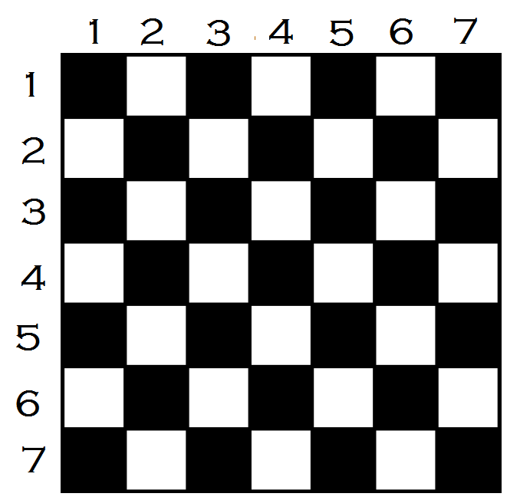
Eg: How many ways are there to select an ordered pair of numbers from 1 to 7 so that the sum is even?
‹#›

Slide 84
Eg: Suppose that a computer science laboratory has 15 workstations and 10 servers. A cable can be used to directly connect a workstation to a server. For each server, only one direct connection to that server can be active at any time. We want to guarantee that at any time any set of 10 or fewer workstations can simultaneously access different servers via direct connections. Although we could do this by connecting every workstation directly to every server (using 150 connections), what is the minimum number of direct connections needed to achieve this goal?
‹#›

Slide 85
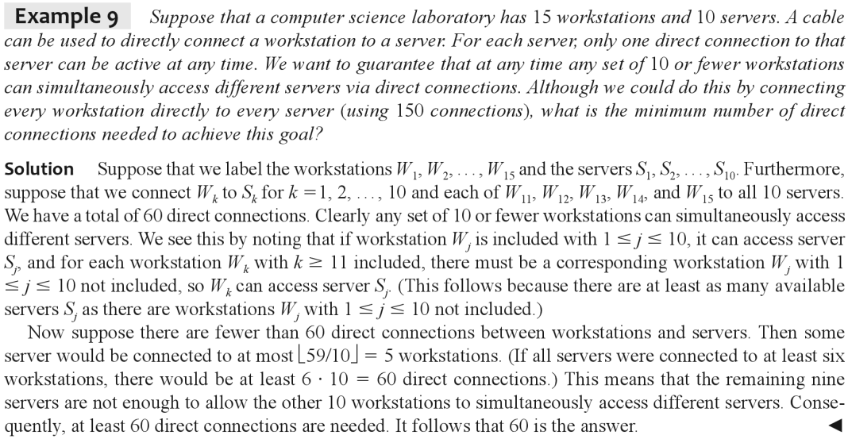
‹#›

Slide 86
Permutations
A permutation of a set of distinct objects is an ordered arrangement of these objects.
r-permutation of a set of distinct objects is an ordered arrangement of some of the elements (say, r) of the set.
The number of r-permutations of a set with n elements is represented by:
P(n, r)
n^{r}
^{n}P_{r}
‹#›

Slide 87
Theorem: r-permutations
If n is a positive integer and r is an integer with
0 ≤ r ≤ n, then there are
P(n, r) = n (n - 1) … (n - r + 1)
Proof: We can find the number of r-permutations using the product rule. There are n choices for the first first object. For each of the n choices, there are (n-1) choices for the second object. For each of the n*(n-1) choices, there are (n-2) choices for the third object and so on up to r^{th} object, which has (n-r+1) choices. Therefore, the number of r-permutations of a set of n distinct objects is,
P(n, r) = n * (n-1) * (n-2) * … * (n-r+1).
‹#›

Slide 88
Corollary: If n and r are integers with 0 ≤ r ≤ n,
then P(n, r) = n! / (n-r)!
P(n, 0) = 1
P(n, r) = n (n - 1) … (n - r + 1)
P(n, r) = {n (n - 1) … (n - r + 1) (n - r)! } / (n - r)!
P(n, r) = n! / (n - r)!
‹#›

Slide 89
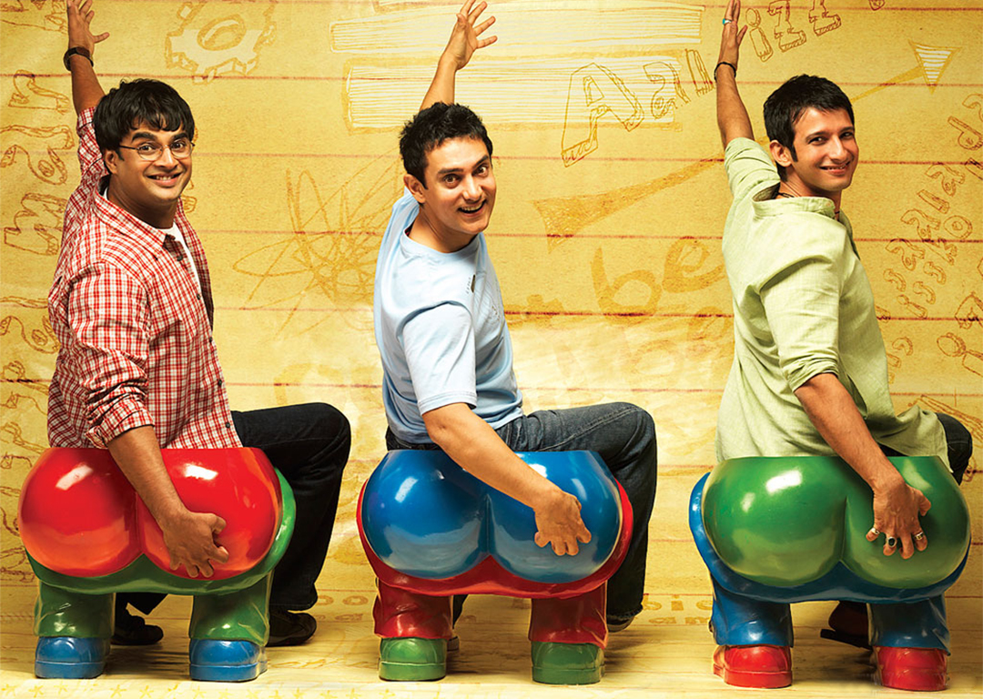
Eg: Suppose a classroom bench can accommodate three students. In how many ways a class of 60 students can sit three at a time on the bench?
Soln: …
‹#›

Slide 90
Eg: Suppose a classroom bench can accommodate three students. In how many ways a class of 60 students can sit three at a time on the bench?
Soln:
= P(60, 3)
= 60 * 59 * 58
= 60! / 57!
Eg: Suppose that a salesman has to visit 9 different cities starting with his origin city. He must begin his trip from the origin city, but he can visit the other 9 cities in any order he wishes. How many possible orders can the salesman use when visiting these cities?
Soln: …
‹#›

Slide 91
Eg: Suppose that a salesman has to visit 9 different cities starting with his origin city. He must begin his trip from the origin city, but he can visit the other 9 cities in any order he wishes. How many possible orders can the salesman use when visiting these cities?
Soln:
= P(9, 9)
= 9!
Eg: How many permutations of the string “ABCDEFGHIJ” contain a sub-string “ABC”?
Soln: …
‹#›

Slide 92
Eg: How many permutations of the letter ABCDEFGHIJ contain the string ABC?
Soln: 8!
Considering ABC as one unit, there are 8 units to permutate.
Imagine listing out all the 10! permutations of the sequence and then searching for the substring “ABC”. The search will have 8! results.
‹#›

Slide 93

An r-combination of elements of a set is an unordered selection of r elements from the set. Thus, an r-combination is simply a subset of the set with r elements.
Eg: How many 2-combinations of {a, b, c, d} are there?
Soln: {a, b}, {a, c}, {a, d}, {b, c}, {b, d}, {c, d}
‹#›

Slide 94
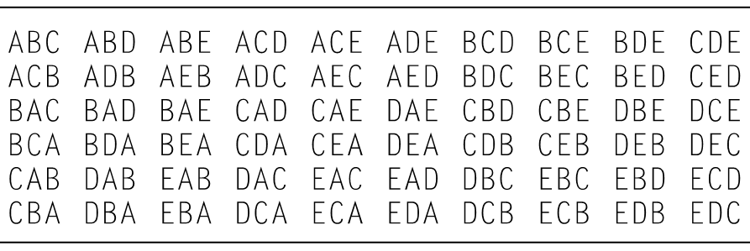
Eg: How many 3-permutations of A, B, C, D, E are there?
Eg: How many 3-combinations of A, B, C, D, E are there?
‹#›

Slide 95
Theorem: The number of r-combinations of a set with n elements, where n is a nonnegative integer and r is an integer with 0 ≤ r ≤ n, equals
n!
C(n, r) = -----------
(n - r)! r!
Proof:
P(n, r) = C(n, r) * r!
…
‹#›

Slide 96
Eg: How many 4-combinations of {a, b, c, d, e, f, g, h, i, j} are there?
Soln: P(10, 4) / 4!
= 10! / ((10-4)! * 4!)
= 10! / (6! * 4!)
= 210
Eg: How many 6-combinations of {a, b, c, d, e, f, g, h, i, j} are there?
Soln: P(10, 6) / 6!
= 10! / ((10-6)! * 6!)
= 10! / (4! * 6!)
= 210
‹#›

Slide 97
Eg: How many poker hands of five cards can be shown from a standard deck of 52 cards?
Soln: …
Eg: From a group of 10 students, in how many ways a committee of 4 students can selected?
Soln: …
Eg: From a group of 10 students, in how many ways a committee of 6 students can selected?
Soln: …
‹#›

Slide 98
Eg: How many poker hands of five cards can be shown from a standard deck of 52 cards?
Soln: 52! / (5! * 47!)
Eg: From a group of 10 students, in how many ways a committee of 4 students can selected?
Soln: 10! / (6! * 4!)
Eg: From a group of 10 students, in how many ways a committee of 6 students can selected?
Soln: 10! / (4! * 6!)
Corollary: Let n and r be nonnegative integers with r <= n. Then C(n, r) = C(n, n - r)
‹#›

Slide 99
Eg: How many bit strings of length 8 contain exactly three 1s?
Soln: …
Eg: How many bit strings of length 8 contain exactly five 0s?
Soln: …
Eg: How many bit strings of length n contain exactly r 1s?
Soln: …
‹#›

Slide 100
Eg: How many bit strings of length 8 contain exactly three 1s?
Soln: 8! / (3! * 5!)
Eg: How many bit strings of length 8 contain exactly five 0s?
Soln: 8! / (5! * 3!)
Eg: How many bit strings of length n contain exactly r 1s?
Soln: n! / ((n-r)! * r!) = C(n, r)
‹#›

Slide 101
Eg: Suppose that there are 9 faculty members in the mathematics department and 11 in the computer science department. How many ways are there to select a committee to develop a discrete mathematics course at a school if the committee is to consist of three faculty members from the mathematics department and four from the computer science department.
Soln: …
‹#›

Slide 102
Eg: Suppose that there are 9 faculty members in the mathematics department and 11 in the computer science department. How many ways are there to select a committee to develop a discrete mathematics course at a school if the committee is to consist of three faculty members from the mathematics department and four from the computer science department.
Soln: C(9, 3) * C(11, 4)
= 84 * 330
= (9 * 8 * 7) * (11 * 10 * 9 * 8) / (3 * 2 * 1 * 4 * 3 * 2 * 1)
= (7 * 11 * 10 * 9 * 4)
= 27,720
‹#›

Slide 103
r-permutation of objects from a set of n objects
Ordered r-selection
n^{r} or ^{n}P_{r}
P(n, r) = n * (n - 1) * … * (n - r + 1) = n! / (n - r)!
P(n, 0) = 1
r-combination of objects from of a set of n obts
Unordered r-selection
^{n}C_{r} or (^{n}_{r})
C(n, r) = P(n, r) / r! = n! / ((n - r)! * r!)
C(n, r) = C(n, n - r)
C(n, 0) = 1
‹#›

Slide 104
Pascal’s Triangle:
1
1 1
1 2 1
1 3 3 1
1 4 6 4 1
1 5 10 10 5 1
1 6 15 20 15 6 1
…
1
1 1
1 2 1
1 3 3 1
1 4 6 4 1
1 5 10 10 5 1
1 6 15 20 15 6 1
…
[OPTIONAL] Q: Write a computer program to print Pascal’s triangle upto n rows.
‹#›

Slide 105
Binomial Expansion of (x+y)^{n}:
(x+y)⁰ = 1
(x+y)¹ = x + y
(x+y)² = x² + 2xy + y²
(x+y)³ = x³ + 3x²y + 3x²y + y³
(x+y)⁴ = x⁴ + 4x³y + 6x²y² + 4xy³ + y⁴
1 5 10 10 5 1
1 6 15 20 15 6 1
1 Pascal’s
1 1 Triangle
1 2 1
1 3 3 1
1 4 6 4 1
1 5 10 10 5 1
1 6 15 20 15 6 1
…
‹#›

Slide 106

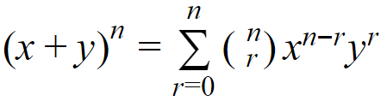
The Binomial Theorem gives the coefficients of the expansion of powers of binomial expressions.
Binomial Theorem: In the expansion of (x+y)^{n} , the coefficient of x^{n-r}y^{r} equals .
Eg: (x+y)³ = (x+y)(x+y)(x+y)
= xxx + xxy + xyx + yxx + xyy + yxy + yyx + yyy
= x³ + 3x²y + 3xy² + y³
‹#›

Slide 107
Eg: (x+y)⁴ = (x+y)(x+y)(x+y)(x+y)
= C(4,0) xxxx +
C(4,1) xxxy +
C(4,2) xxyy +
C(4,3) xyyy +
C(4,4) yyyy
= x⁴ + 4x³y + 6x²y² + 4xy³ + y⁴
‹#›

Slide 108


Binomial Theorem: In the expansion of (x+y)^{n} , the coefficient of x^{n-r}y^{r} equals .
Proof: We can prove it by a combinatorial method.
The terms in the product when it is expanded are of the form x^{n-r}y^{r} for r=0,1,2, …, n.
To count the number of terms of the form x^{n-r}y^{r} , note that to obtain such a term it is necessary to choose n-r xs from the n sums and the other r terms in the product are obviously ys.
Therefore, the coefficient of x^{n-r}y^{r} is , which is equal to . Hence the proof.
‹#›

Slide 109
Eg: What is the expansion of (x+y)⁵?
Soln: x⁵ + 5x⁴y + 10x³y² + 10x²y³ + 5xy⁴ + y⁵
Eg: What is the coefficient of x³y² in the expansion of (x+y)⁵ ?
Soln: C(5,3)
‹#›

Slide 110
Eg: What is the coefficient of x¹³y¹⁴ in the expansion of (x+y)²⁷ ?
Soln: C(27, 13)
Eg: What is the coefficient of x¹²y¹³ and also x¹³y¹² in the expansion of (2x - 3y)²⁵ ?
Soln:
C(25, 12) * 2¹² * (-3)¹³
C(25, 12) * 2¹³ * (-3)¹²
‹#›

Slide 111
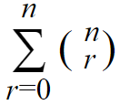
Corollary: Let n be a nonnegative integer. Then
= ?
Hint:
(x+y)³ = (x+y)(x+y)(x+y)
= xxx + xxy + xyx + xyy + yxx + yxy + yyx + yyy
= x³ + 3x²y + 3xy² + y³
(x+y)⁴ = (x+y)(x+y)(x+y)(x+y)
= x⁴ + 4x³y + 6x²y² + 4xy³ + y⁴
‹#›

Slide 112
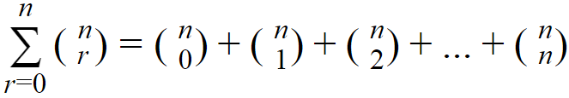
= number of bit strings of length n having 0 1s
+ number of bit strings of length n having 1 1s
+ number of bit strings of length n having 2 1s
…
+ number of bit strings of length n having n 1s
= all possible bit strings of length n counted exactly once
= 2^{n}
We could also explain using subsets of a set adding up to power set.
‹#›

Slide 113
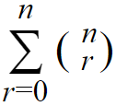
Corollary: Let n be a nonnegative integer. Then
= 2^{n}
Proof: (algebraic)
2^{n} = (1+1)^{n} = 1^{r}1^{n-r} =
The proof using set theory principles is a “combinatorial proof”.
‹#›

Slide 114
Corollary: For a positive integer n, prove that
(-1)^{r} = 0
Proof: (algebraic)
0 = 0^{n} = ((-1)+1)^{n}
= (-1)^{r}1^{n-r} = (-1)^{r}
‹#›

Slide 115
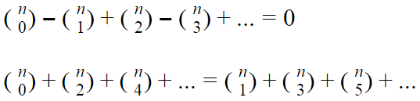
(-1)^{r} = 0
1
1 - 1 = 0
1 - 2 + 1 = 0
1 - 3 + 3 - 1 = 0
1 - 4 + 6 - 4 + 1 = 0
1 - 5 + 10 -10 + 5 - 1 = 0
1 - 6 + 15 - 20 + 15 - 6 + 1 = 0
1 - 7 + 21 - 35 + 35 - 21 + 7 - 1 = 0
1 - 8 + 28 - 56 + 70 - 56 + 28 - 8 + 1 = 0
…
‹#›

Slide 116
(-1)^{r} = 0
Any combinatorial proof for the corollary?
Eg: How many bit strings of length 10 have even number of 1s in it?
Soln: Same as that the odd number of 1s in it.
= 2^{n} / 2 = 2^{n-1}
‹#›

Slide 117
Corollary: For a positive integer n, prove that
2^{r} = 3^{n}
Proof: (algebraic)
3^{n} = (1+2)^{n} = …
Any combinatorial proof for the corollary?
‹#›

Slide 118

Pascal’s Identity:
1
1 1
1 2 1
1 3 3 1
1 4 6 4 1
1 5 10 10 5 1
1 6 15 20 15 6 1
…
1
1 1
1 2 1
1 3 3 1
1 4 6 4 1
1 5 10 10 5 1
1 6 15 20 15 6 1
…
Theorem: Let n and k be positive integers with
n >= k. Then
‹#›

Slide 119
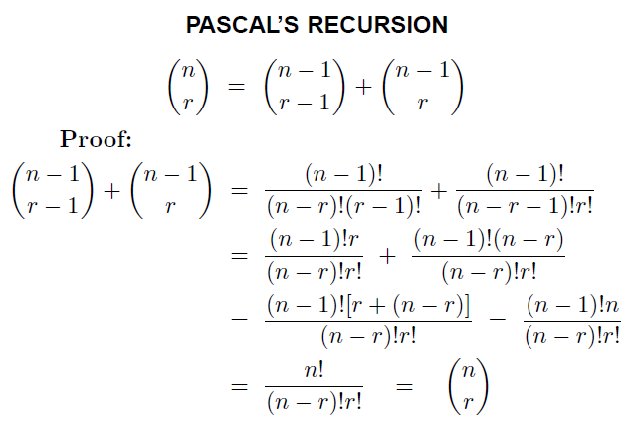
Pascal’s Identity: (Algebraic Proof)
‹#›

Slide 120

Proof: (Combinatorial method)
Suppose that T is a set containing n+1 elements.
There are subsets of T containing k elements.
Let ‘a’ be an element in T.
A subset of T either contains a along with k-1 elements from T - {a}, or doesn’t contains a and contains k elements from T - {a}. These two sets are disjoint.
‹#›

Slide 121
subsets of T containing k elements
=
Subsets containing a with k-1 elements from T-{a}
+
Subsets not containing a and containing k elements from T-{a}.
∴
‹#›

Slide 122
1
1 1
1 2 1
1 3 3 1
1 4 6 4 1
1 5 10 10 5 1
1 6 15 20 15 6 1
…
1
1 1
1 2 1
1 3 3 1
1 4 6 4 1
1 5 10 10 5 1
1 6 15 20 15 6 1
…
Pascal’s Triangle generation:
[Optional] Write a computer program to print Pascal’s triangle upto n rows using Pascal’s identity.
Base cases: (^{n}₀) = (^{n}_{n}) = 1
You won’t need multiplications, only additions are good enough.
‹#›

Slide 123
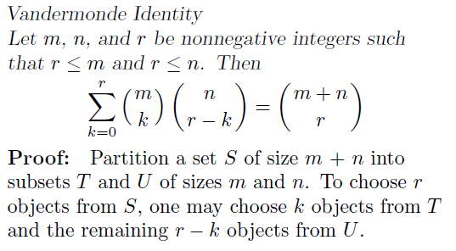
‹#›

Slide 124
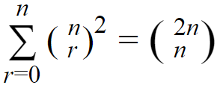
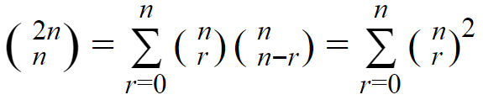
Corollary: For a nonnegative integer n, prove that
Proof: By Vandermonde’s identity
‹#›

Slide 125
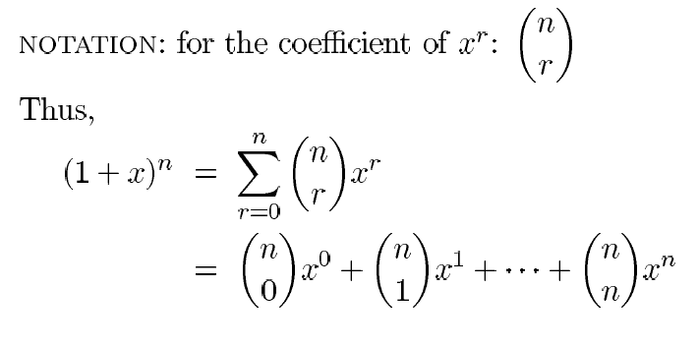
Binomial Coefficients: are the coefficients of the terms x^{r} in the expansion of the binomial (1+x)^{n}
‹#›

